Slide 1
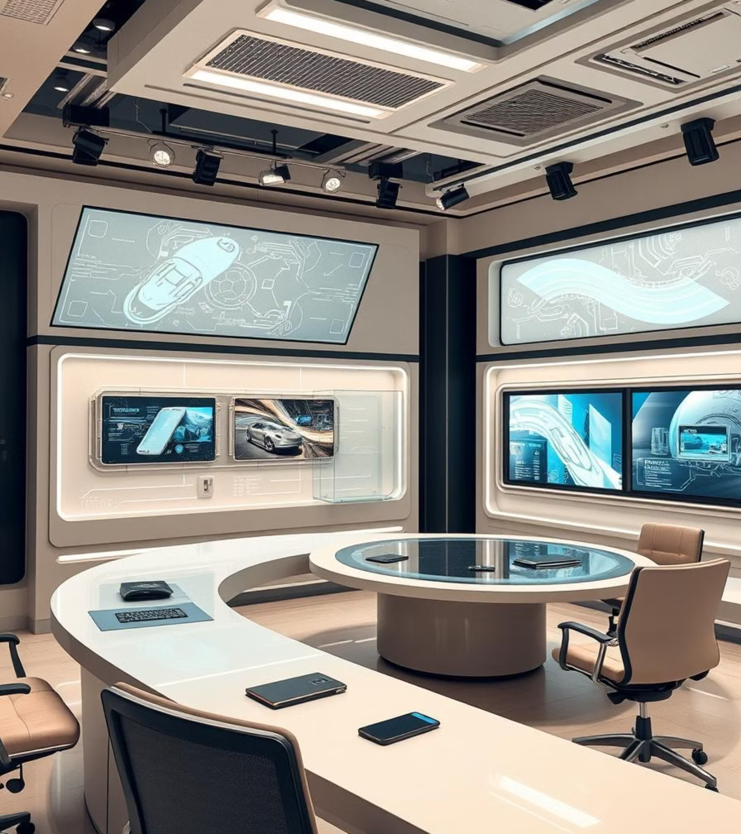
AI Newsroom Generator
An AI-Powered Content Creation Web App
By
Anjali Dhindhwal

Slide 2



Project Overview
User Input
AI Processing
Article Output
A short news brief is provided by the user.
The brief is transformed into a detailed article via AI.
A high-quality, comprehensive article is generated.
This full-stack web application is designed to streamline content creation, helping users generate detailed articles from simple news briefs efficiently.

Slide 3




Submission Highlights
Organised Structure
Clean Code
Source code, screenshots, and a detailed report are neatly organised.
The code is well-commented and easy to understand.
Demonstrative Screenshots
Comprehensive Report
Screenshots clearly show the application's working output.
A detailed report outlines design, implementation, and challenges.

Slide 4
Key Features & Workflow
Input News Brief
1
Users provide a concise news brief to initiate the process.
AI Article Generation
2
The application leverages an AI prompt to construct a complete article.
Display Results
3
The generated article is presented within a clean and intuitive user interface.
Clarity & Usability
4
The primary focus is on ensuring a clear and user-friendly experience.

Slide 5

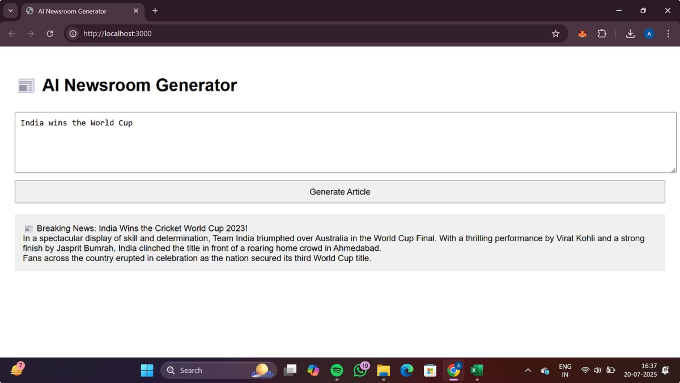
Live Demo: Screenshot
Witness the AI Newsroom Generator in action. Observe the seamless transition from a simple news brief to a fully articulated article, showcasing the application's core functionality.
Example Input: "India wins the World Cup"

Slide 6
Report Summary
Purpose & Problem Statement
Architecture & Tech Stack
Explains the core need this application addresses in content creation.
Detailed insights into the system's design and technological foundation.
Implementation Process
Challenges & Solutions
A step-by-step breakdown of how the application was built.
Discusses obstacles encountered and the innovative solutions applied.

Slide 7






Technologies Used
HTML
CSS
Structuring the web content.
Styling the user interface.
JavaScript
Node.js
Enabling interactive frontend features.
Backend runtime environment.
Express.js
AI Text Generation
Backend web framework.
Core content generation logic using prompt templates.

Slide 8
Why This Project Stands Out
Solves a real-world content creation need, offering a practical solution for efficiency.
Presents an end-to-end solution: from initial design to code, a live demo, and comprehensive reporting.
Emphasis on a clean UI, clarity, and exceptional user experience ensures broad appeal and ease of use.
Demonstrates strong initiative in full-stack development, showcasing diverse technical capabilities.

Slide 9
Conclusion & Next Steps
Working Project
1
The application is fully functional, rigorously tested, and thoroughly documented.
Ready for Review
2
We welcome your feedback and evaluation of the project.
Future Enhancements
3
Plans include user authentication, article saving, and advanced AI prompt refinement for even greater utility.

Slide 10
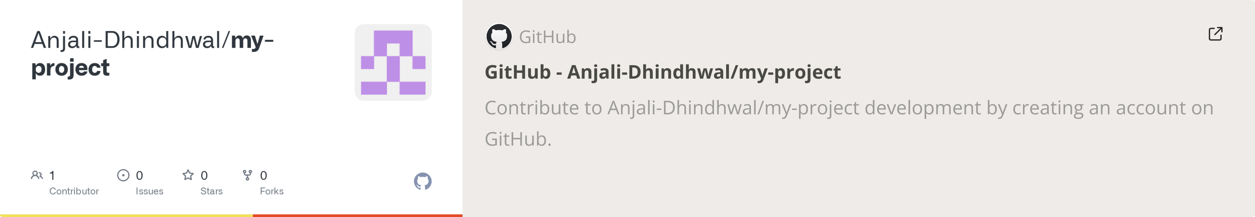
Thank You
GitHub Repository:-

